Slide 1
Federal Funding
LSTA Grant from IMLS

Slide 2
FY 20 Funding (FFY19)
$1.8 million per year
2 years to spend the money

Slide 3
How we use IMLS funds
4 full-time staff salaries and benefits ($415,000)
4% Administrative Fee ($75,000) – goes to Dept. of Education
Programs and Resources to help Iowa libraries

Slide 4
Programs
PLOW- website hosting
SILO-interlibrary loan, email accounts, DNS
Continuing Education
Accreditation
Certification
Summer Reading
EDGE
Iowa Center for the Book
AIR – Adult, Teen, Kids
Letters About Literature
Literacy Grant
State Data Center
PL Statewide Delivery
WhoFi

Slide 5
Resources
Iowa Locator – union list of materials
Online Resources:
Gale, Credo, Transparent Languages, Chilton Auto, First Search, Foundation Directory Online, H.W. Wilson Core Collection, Opposing Viewpoints
E-Rate Support
Library Science Professional Collection
Bridges – manage the consortium
Library Talk
Sub-Grants
Academic Delivery Grants
Continuing Ed Grants – ARSL, YALSA,
Leadership Institute Grant
Space Utilization Grants
Technology Grants

Slide 6
Online Resources - Cost Shared with libraries
Gale and Chilton Auto - $405,036 (=60% of cost)
Credo - $86,430 (=60% of cost)
Transparent Languages - $25,200 (=60% of cost)
(Contracts end 4/30/2022)
$516,666 – State Library’s share

Slide 7
Online Resources – State Library Pays total cost
OCLC First Search - $103,283
Foundation Directory Online - $24,000
H.W. Wilson Core Collection - $40,845
Westlaw - $40,546
(contracts end 6/30/2020)
Opposing Viewpoints - $220,747 (contract ends 4/30/2022)
Reference USA - $4,995 (contract ends 4/30/2020)
$434,416

Slide 8
SILO/PLOW/LOCATOR
SILO ILL
PLOW Website hosting
Email hosting
DNS service
$278,000

Slide 9
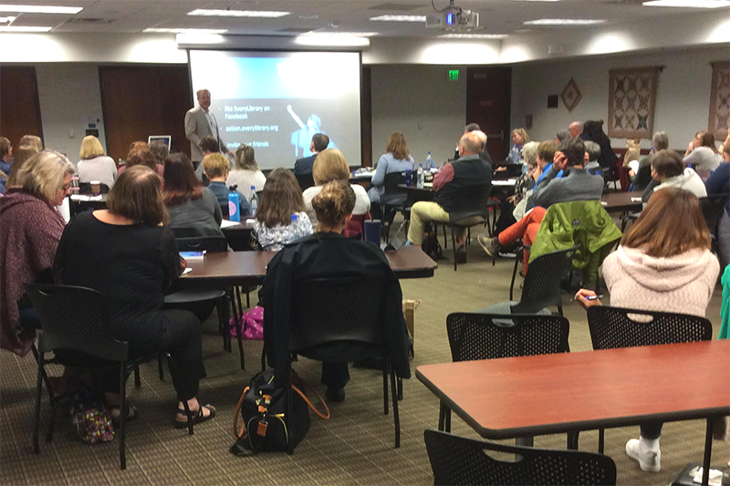
Continuing Education
Software to run program
Speakers/Instructors
Room Rentals
$34,800

Slide 10
Sub-Grants
Academic Delivery Grants – FY20 – future TBD
ARSL Grants –FY20 – future TBD
Space Utilization Grants - ongoing
Leadership Institute Grant –ongoing-every 2 years
Technology Grants – FY20 – future TBD
YALSA Connected Learning Grants – FY20
$397,765

Slide 11
Miscellaneous Programs
EDGE - $50,000
Accreditation/Annual Survey - $33,160
Library Science Prof. Collection - $10,000
Summer Reading - $8,200
Iowa Center for the Book - $13,000
WhoFi - $133,000
$247,360

Slide 12
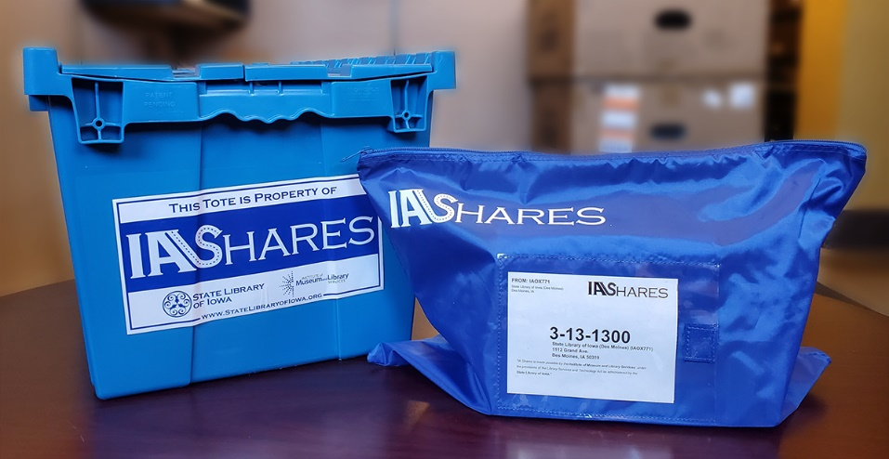
Statewide Delivery
1 Day per Week to Public Libraries
Start-up Costs
Bags
Totes
Labels
$499,764

Slide 13
Reflection
Think about these programs and resources and how they affect the libraries you represent in best and worst case scenarios
Write down your thoughts
Share with the group

Slide 14
Assignment
Reach out to your type of library to get their feedback on this question.
Collect responses
Email to Michael
Michael.Scott@iowa.gov

